Slide 1


Introduction to ReactJs
L. ATRI DATTA RAVI TEZ
ASST. PROFESSOR & WEB ADMIN

Slide 2


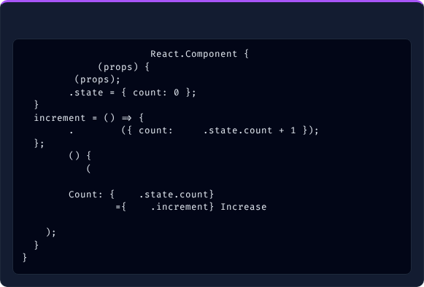
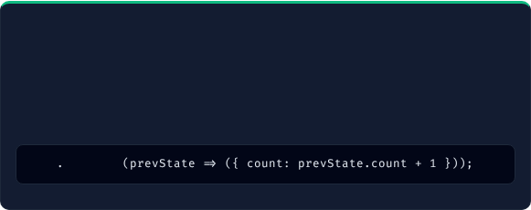


11. State in React
What is State? & Key Points
State in Class Component Example
•
Built-in Object: Stores property values belonging to a component.
class
Counter
extends
•
Triggers Re-render: When state changes, the component re-renders.
constructor
•
Mutable & Private: Managed internally inside the component.
super
•
Class Components: Initialized in constructor, accessed via this.state, updated via this.setState().
this
// Initial state
•
Functional Components: Uses useState() hook (React 16.8+).
this
setState
this
render
return
this
onClick
this
>
How setState() Works & Rules
State vs Props Quick Summary
•
Schedules an update; batches multiple calls for performance.
Feature | State | Props
Mutable | Yes (Can be changed) | No (Read-only)
Owned By | Component itself | Passed by Parent
Updated Using | setState() / Hook | Parent Component
Triggers Re-render | Yes | Yes (when changed)
•
Asynchronous: Does NOT update state immediately.
•
Rule: Do NOT modify state directly (this.state.count = 1 ❌).
•
Functional Updates: Use callback for multiple updates:
this
setState

Slide 3
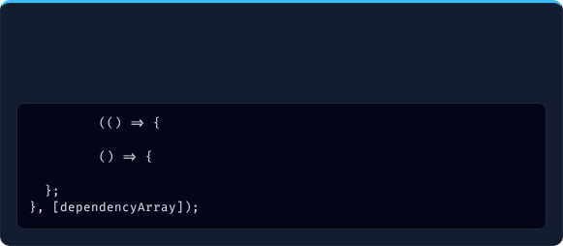

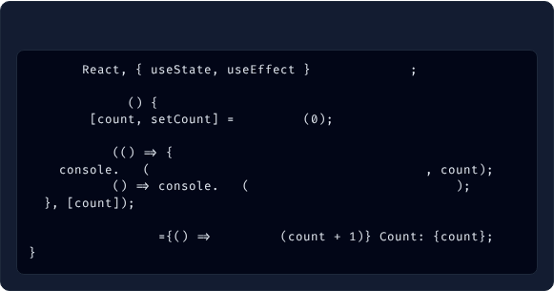


12. Effect Hook (useEffect)
What & Syntax of useEffect
Cleanup Function & Use Cases
Performs side effects in function components (runs after rendering). Used for API fetching, timers, subscription, DOM manipulation.
Cleanup runs: Before component unmounts OR before re-running effect on dependency change.
Use Cases: 1. Fetching API data | 2. Subscriptions | 3. Timer intervals | 4. Resource cleanup
useEffect
// Side effect code
return
// Cleanup code (optional)
Example Code with Cleanup
useEffect Behavior Summary
import
from
'react'
Dependency Array | When It Runs | Cleanup Runs | Use Case
[] (Empty) | Once after first render | On unmount | API fetch, initial setup
[dep] (With values) | When dep changes | Before next run & unmount | Updates based on props/state
No array | After every render | Before next run & unmount | Rare use (not recommended)
function
User
const
useState
useEffect
log
"Component mounted / Count changed:"
return
log
"Cleanup on unmount/change"
// Runs on count change
return
onClick
setCount
>

Slide 4









13. Lifecycle Methods (Class Components)
React components go through 3 primary phases in their lifecycle:
1. Mounting (Birth)
→
2. Updating (Change)
→
3. Unmounting (Death)
Added to DOM
State/Props change
Removed from DOM
1. Mounting Phase
2. Updating Phase
3. Unmounting Phase
•
1. constructor()
•
1. getDerivedStateFromProps()
•
1. componentWillUnmount() 🗑️
•
2. getDerivedStateFromProps()
•
2. shouldComponentUpdate()
•
3. render()
•
3. render()
•
4. componentDidMount() ✓
•
4. componentDidUpdate() ✓
Class Lifecycle vs Hooks Equivalent
Best Practices
Class Method | Functional Hook Equivalent
componentDidMount() | useEffect(() => {}, [])
componentDidUpdate() | useEffect(() => {}, [deps])
componentWillUnmount() | useEffect(() => { return () => {} }, [])
•
Understand lifecycle methods before switching to Hooks.
•
Use lifecycle methods only in Class Components.
•
Prefer Functional Components + Hooks for all new modern projects.

Slide 5


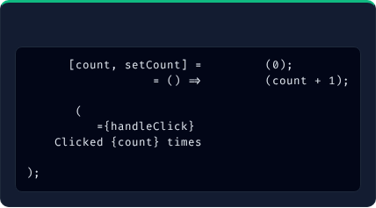
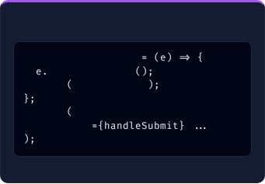
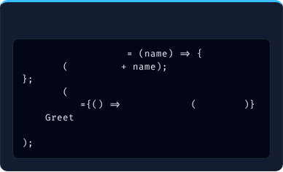
14. Handling Events
What are Events & Key Points
Common Events List
•
Events are browser actions (e.g., click, change, submit).
1. onClick - Clicked
5. onMouseLeave - Hover out
•
React uses camelCase naming (onClick, onChange).
2. onChange - Input changed
6. onKeyDown - Key pressed
•
Pass a function reference, not a string or direct execution.
3. onSubmit - Form submit
7. onFocus - Element focused
•
Use e.preventDefault() to prevent page reloads.
4. onMouseEnter - Hover in
8. onBlur - Focus lost
1. Button Click Example
2. Prevent Default Example
3. Passing Arguments
const
useState
const
handleSubmit
const
handleClick
const
handleClick
setCount
preventDefault
// Stops reload
alert
"Hello "
alert
"Submitted!"
return
return
onClick
>
return
onClick
handleClick
"Roshan"
>
onSubmit
>

Slide 6
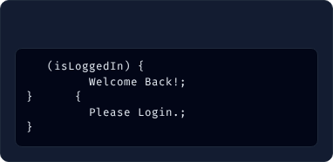
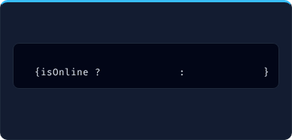
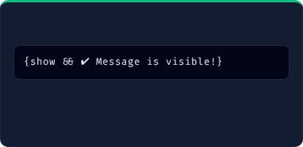

15. Conditional Rendering
Render different UI elements based on state, props, or conditions (if/else, ternary, &&, !, switch):
1. if / else Statement
2. Ternary Operator (? :)
3. Logical AND (&&)
if
return
"🟢 Online"
"🔴 Offline"
else
return
Method | Use Case | Syntax Example | Best For
if / else | Complex block logic | if (cond) { return A } else { return B } | Large structural blocks
Ternary (? :) | Simple true/false UI | cond ? : | Inline short UI toggles
&& Operator | Render only if true | cond && | Single optional elements
! Operator | Render opposite | !error && | Negative conditions
switch | Multiple fixed cases | switch(type) { case 'a': ... } | Multi-option matching

Slide 7

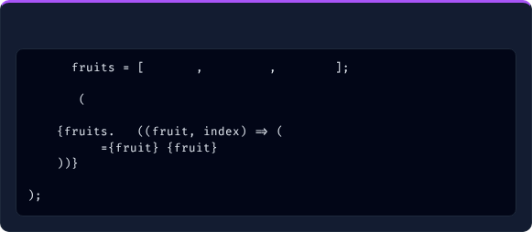



16. Lists and Keys
What are Lists & Why Keys?
Rendering List Example
•
Render lists using JS array map() function.
const
'Apple'
'Banana'
'Mango'
•
Key Prop: Unique identifier required for each list item.
•
Why Keys Matter: Helps React track changed/added/removed items, improves performance, prevents unnecessary re-renders.
return
map
key
>
Useful Array Methods in React Lists
Do's and Don'ts for Keys
Method | Purpose
map() | Transforms array items into list of JSX elements.
filter() | Creates new array with elements passing a condition.
slice() | Returns a portion of array without modifying original.
•
✔ DO: Always use unique ID (e.g. key={user.id}).
•
❌ DON'T: Avoid using array index if order can change.
•
❌ DON'T: Never use random numbers (Math.random()).

Slide 8

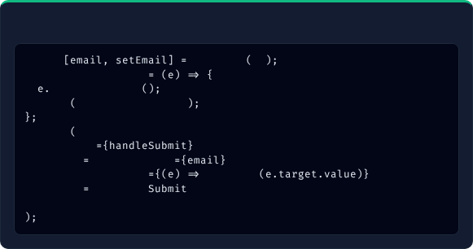
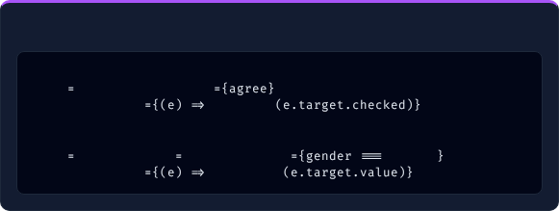

17. Forms in React
Controlled Components
Simple Form Example
Form data is handled by React state ("single source of truth"). Input value is set from state, and onChange updates state.
const
useState
''
const
handleSubmit
Supported Input Types: text, email, password, number, checkbox, radio, date, file.
preventDefault
alert
`Email: ${email}`
return
onSubmit
>
type
"email"
value
onChange
setEmail
/>
type
"submit"
>
Checkbox & Radio Examples
Form Validation & Use Cases
// Checkbox
•
Check inputs (if (!email.includes('@')) setError('Invalid Email')).
type
"checkbox"
checked
•
Display clear error messages under fields.
onChange
setAgree
/>
•
Common Use Cases: Login/Signup forms, Contact forms, Surveys.
// Radio
type
"radio"
value
"male"
checked
'male'
onChange
setGender
/>

Slide 9






18. State and Props
Comprehensive comparison and data flow of State and Props:
Initial State
→
User Action
→
State Updates
→
Re-render
→
UI Updated
count = 0
Clicks Button
setCount(count+1)
Virtual DOM Diffs
Display New Count
Feature | State | Props
Definition | Data managed inside component | Data passed from parent to child
Mutable | Yes (via useState / setState) | No (Read-only immutable)
Scope & Flow | Component level (Internal) | Parent → Child (Unidirectional)
Purpose | Handle dynamic interaction & changes | Reuse components & pass parameters
Best Practice Summary:
State
Props

Slide 10
Complete ReactJS Fundamentals!
You have covered all 18 topics from Introduction to Advanced React Concepts!
L. ATRI DATTA RAVI TEZ
ASST. PROFESSOR & WEB ADMIN

